Slide 1
Remote Labs Suggested Changes

Slide 2
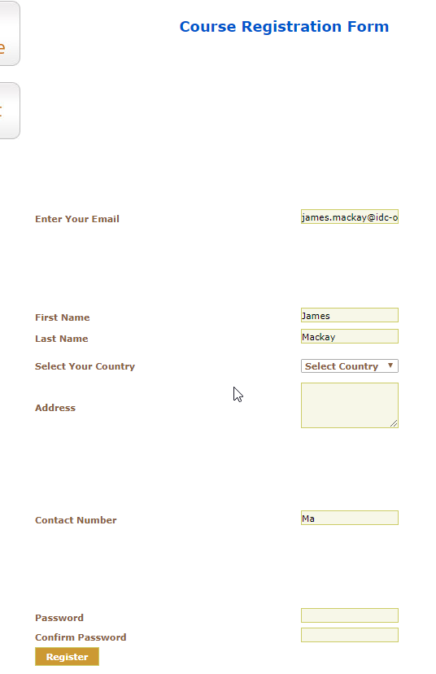
Registration Form
Issue/Fix
Screenshot
The registration form isn’t appealing to look at. The tab order is also a mess.
Complete redo of the form. Assuming this will be embedded on the new Electromeet website.

Slide 3
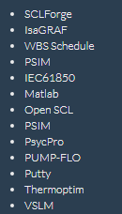
Homepage Description
Issue/Fix
Screenshot
Dot points needed to be added to the options available for a lab.
Before
After

Slide 4
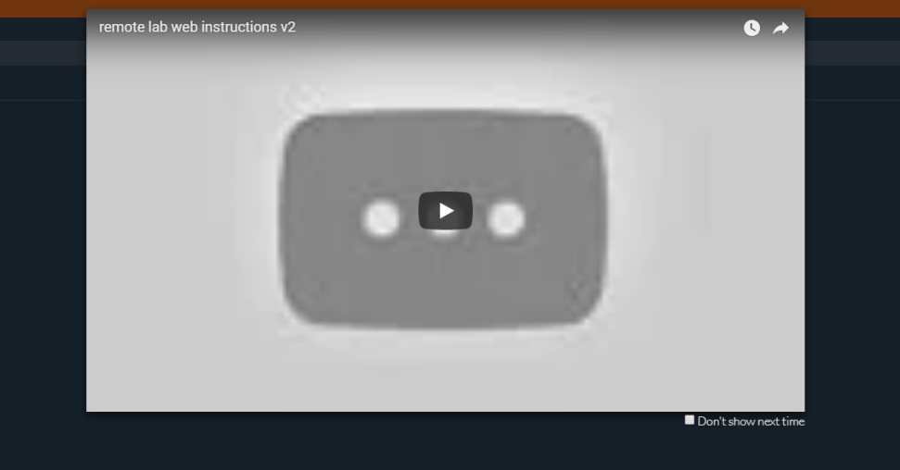
Instruction Video
Issue/Fix
Screenshot
Instruction video needs to be updated.
I will make a video once the final touches to the Remote Lab have been made.

Slide 5

Header Declaration
Issue/Fix
Screenshot
The title ‘List of available remote labs’ should be wrapped in a header tag.
Wrap it in either an ‘<h1>’ or ‘<h2>’. This will allow me to target it with CSS.

Slide 6
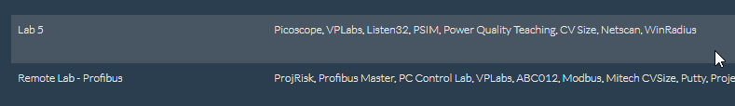
Lab Selection Text Positioning
Issue/Fix
Screenshot
The text within each row of the table should be centred.

Slide 7
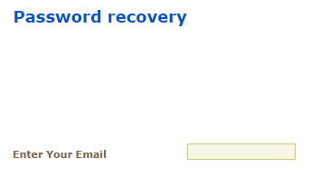
Password Recovery
Issue/Fix
Screenshot
Another page isn’t necessary. Selecting ‘Password recovery’ should simply send an email to the user with the updated details.

Slide 8
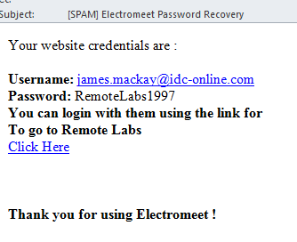
Email Received
Issue/Fix
Screenshot
Remove ‘[SPAM]’ from the subject line.
Change the bottom text to ‘Thankyou for using our Remote Labs’.

